Slide 1
Digging into Kickstarter Data
Elif Kır
Hasan Alperen Tosun
Ufuk Seçilmiş
Taha Bayaz

Slide 2
Introduction
➦ Is it possible to predict by using previous crowdfunding data and machine learning algorithms whether an idea is good enough to be funded?
➦ Kickstarter.com is a website where people with ideas but without money go online and ask for donations.
➦ This dataset consists of more than 300,000 projects which were launched at the website before the 01.02.2018.

Slide 3
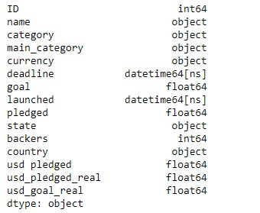
Introduction
➦ The techniques we used to process the data are Decision Tree and Naive Bayes Classifiers.

Slide 4
Economic theory of creative destruction.
➦ The main implications of our research are for modern economic theory within the creative destruction and entrepreneurship paradigms.
➦ The idea of creative destruction lies on the fact that the old and inefficient firms will be destroyed and put out of business environment by new and efficient firms to reach a better output/input ratio, i.e. more productive industries.
➦ Our work stems from the theoretical and empirical importance of new businesses and start-ups.
➦ A mechanism that predicts which firms are worthy to be funded is extremely helpful in order to accelerate economic growth.

Slide 5
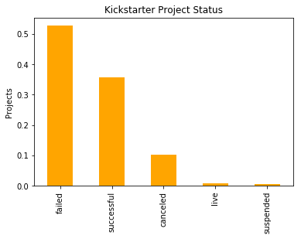
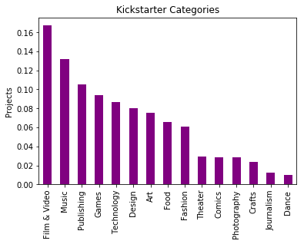
Data Exploration
➦ We first convert deadline and launched dates to datetime objects, then convert goal, pledged and backers columns to numeric objects.
➦ The next step is to rule out the unusable data from the dataset

Slide 6
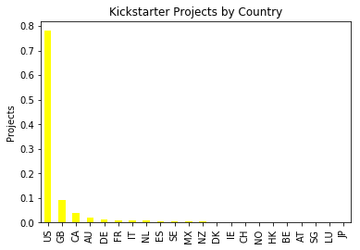
Data Exploration

Slide 7
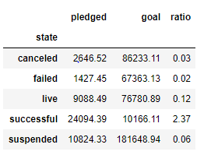
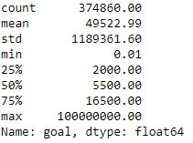
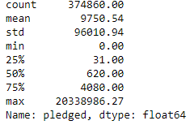
Data Exploration
Descriptive Statistics

Slide 8
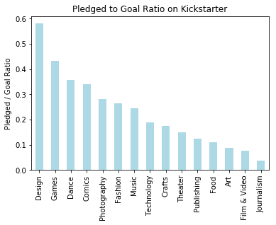
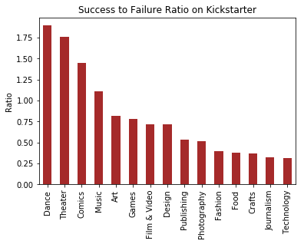
Data Exploration
High Success: Dance, Theatre, Comics and Music projects Moderate Success: Following six categories, Art, Games, Film & Video, Design, Publishing and Photography Shallow Success

Slide 9
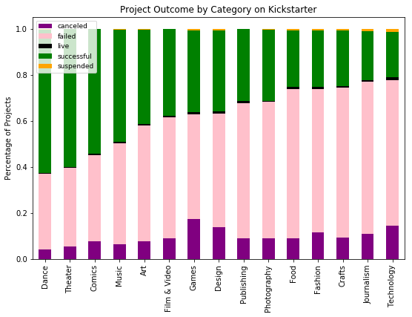
Data Exploration

Slide 10
Methodology
➦ In our project, we applied two types of classifiers. The first one is Decision Tree Classifier and the second one is Naive Bayes Classifier.
➦ A decision tree is a decision support tool that uses a tree-like graph or model of decisions and their possible consequences, including chance event outcomes, resource costs, and utility.
➦ A Naive Bayes classifier is a machine learning method which benefits from the probabilistic approach. The logic of the classifier is based on the Bayes theorem.
P(A|B) = P(B|A) P(A)P(B)
It requires categorical variables to be applied. Its main algorithm is as follows:
For a response with m classes C1,C2,...,Cm and the predictors x1, x2, ... ,xp, compute P(Ci|x1, . . . , xp)

Slide 11
Results
➦ We reached 67% accuracy rate as designing model in the training part of the data at the decision tree method,which is good enough because after a point high accuracy rate implies a high error rate as well.
➦ As applying Naive Bayes model, the accuracy rate is around 44%, which is not predictive enough. The confusion matrices are consistent with this comparison.

Slide 12
Conclusion
➦ Our work’s foundations lies on the economic theory of creative destruction. Stemming from the questions we asked about the success of new ideas, we developed a framework to study the data from the crowdfunding website, Kickstarter.
➦ We divided the projects into three sets according to their state: i) high success ii) moderate success and iii) shallow success
➦ Our work puts the machine learning tools together with the economic theory.
➦ The Decision Tree Classifier is accurate around 67%, which is an improvable overall accuracy. The Naive Bayes Classifier has a worse overall accuracy, nearly 44%.

